Slide 1
Relational Deep Learning

Slide 2
Overview
Relational databases
Relational deep learning

Slide 3
Relational databases

Slide 4
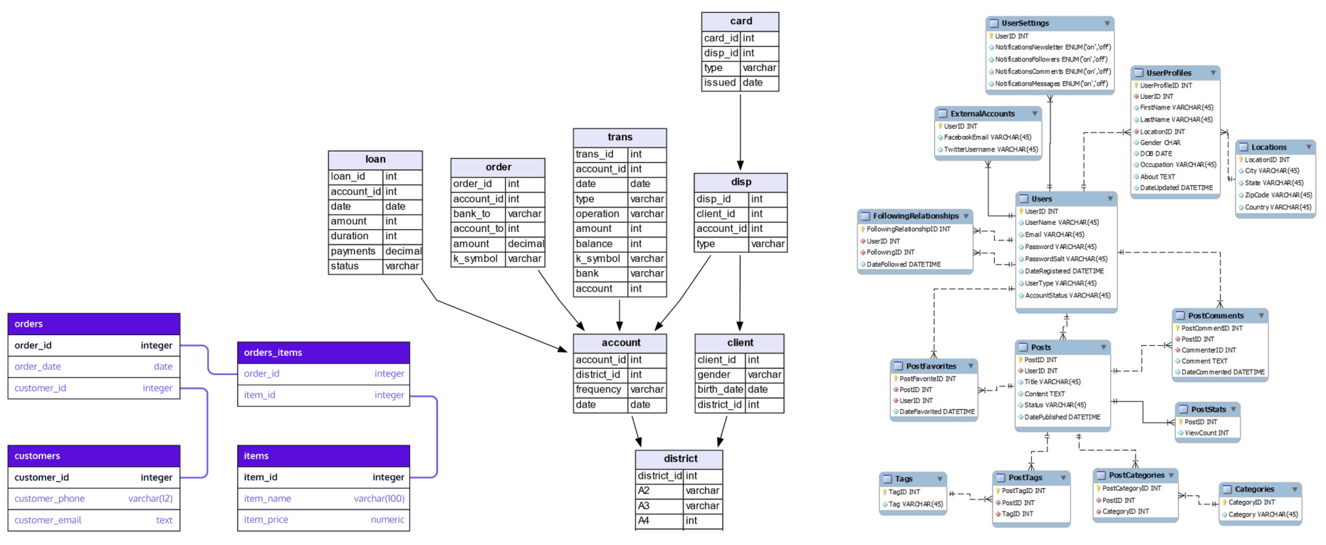
Relational databases
All technology stacks rely on a database management system (DBMS)
Most (not all) use relational databases

Slide 5
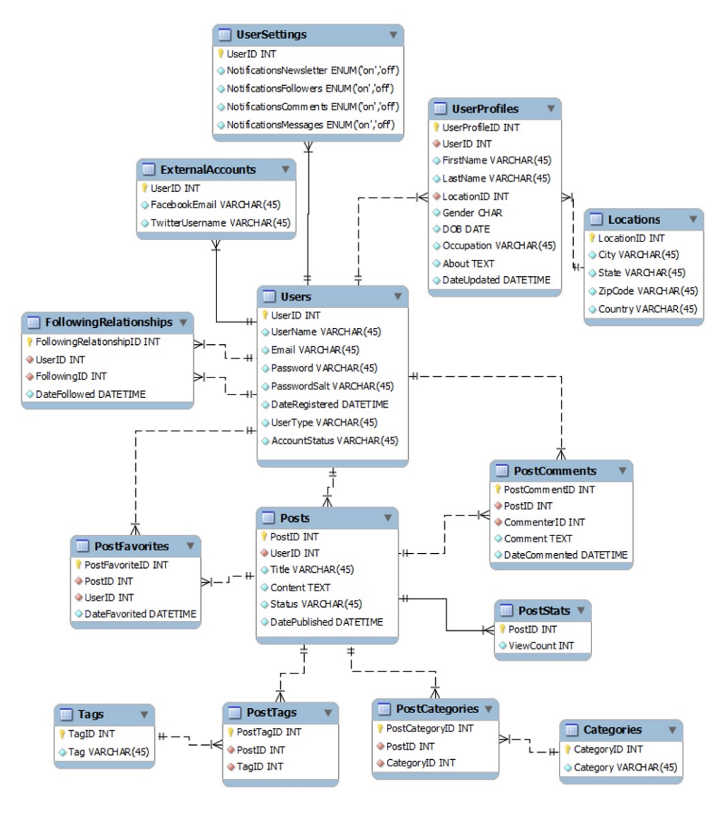
Relational databases
Data is stored in a set of tables
Each table stores entities in rows that:
Have the same features
Have a unique primary key (PK)
May have one or more foreign keys (FK) connecting the entity to another table
May have a time stamp
Image credit: Jure Leskovec, http://cs224w.stanford.edu

Slide 6
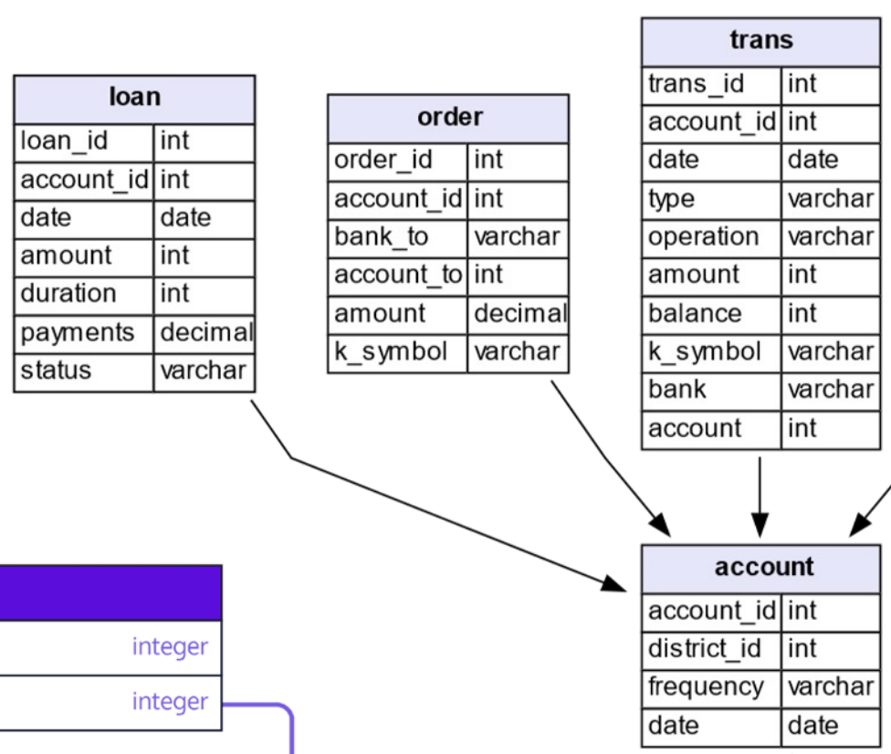
Relational database schema
Loan table
Each column (feature) has a fixed type (e.g., integer, date, text, image)
Each table has a distinct set of columns (features)
Image credit: Jure Leskovec, http://cs224w.stanford.edu

Slide 7
Relational database schema
Loan table
Many tables include a timestamp feature indicating when the entity was added to the database
Image credit: Jure Leskovec, http://cs224w.stanford.edu

Slide 8
Relational database schema
Loan table
Primary Key: loan_id
distinct for every row in the table
Foreign Key: account_id links a row to a primary key value (row) in another table
Primary Key: different tables may use the same name for the primary key. They are distinct by the combination of table name (which cannot be duplicated) and primary key name
Primary Key: account_id
Account table
Image credit: Jure Leskovec, http://cs224w.stanford.edu

Slide 9
Relational database schema
Loan table
loan_id | account_id | date | amount | duration | payments | status
1 | 27 | 012425 | 137.50 | 30 | 360 | C
2 | 12 | 040201 | 39.59 | 15 | 180 | D
Account table
Foreign key
account_id | disdrict_id | frequency | date
12 | A | 12 | 011025
27 | Z | 12 | 032700
Image credit: Jure Leskovec, http://cs224w.stanford.edu

Slide 10
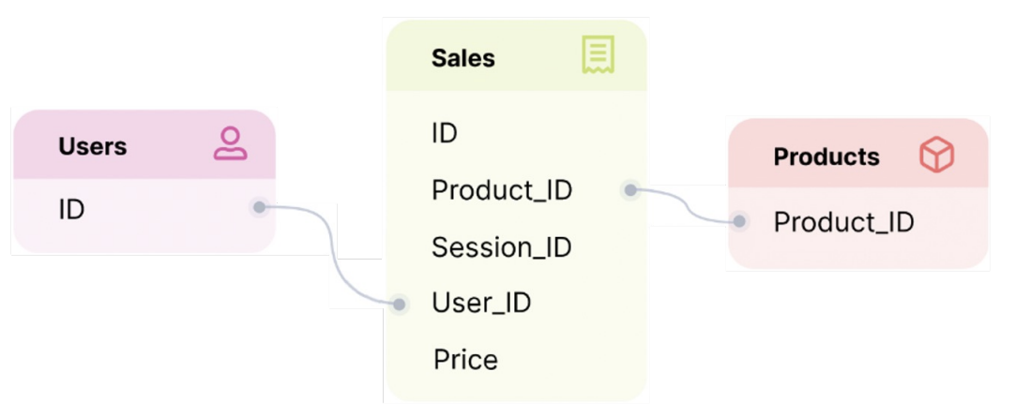
Predictions with relational databases
Which products will a user purchase in the next 7 days?
Will an active user churn in the next 90 days?
What will be the total sales for each product in the next 30 days?
Image credit: Jure Leskovec, http://cs224w.stanford.edu

Slide 11
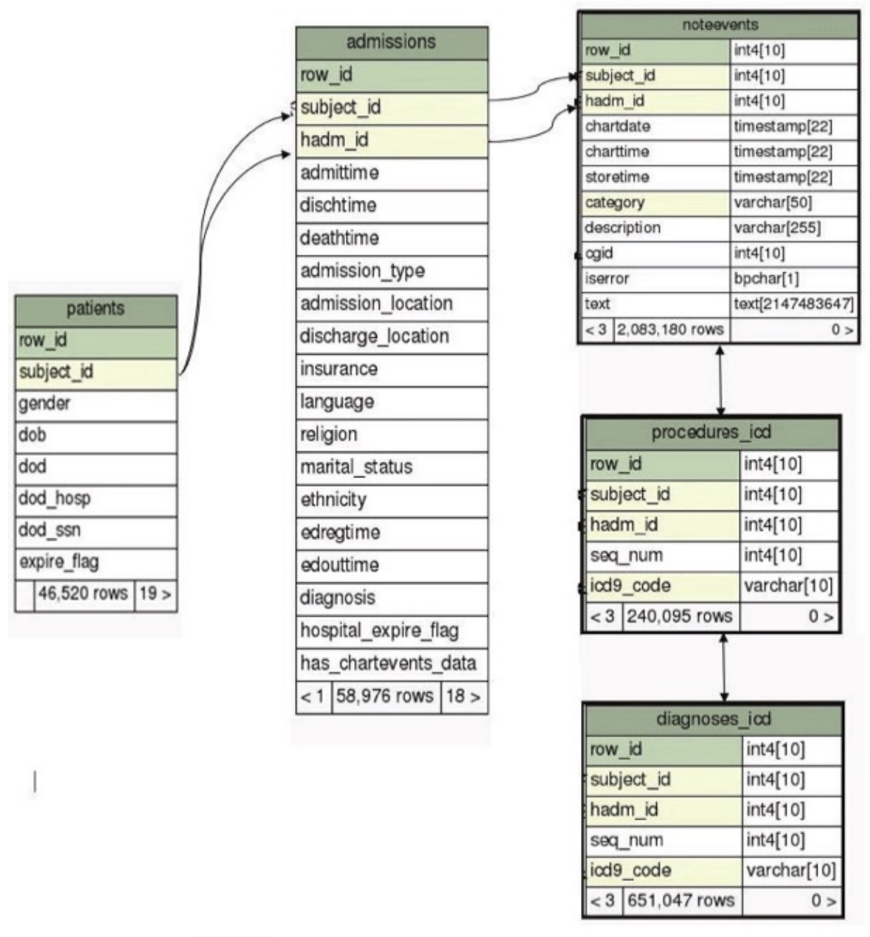
Predictions with relational databases
Will a patient return if discharged from the hospital?
Which hospital admissions have greatest risk to life in the next 24 hours
Image credit: Jure Leskovec, http://cs224w.stanford.edu

Slide 12
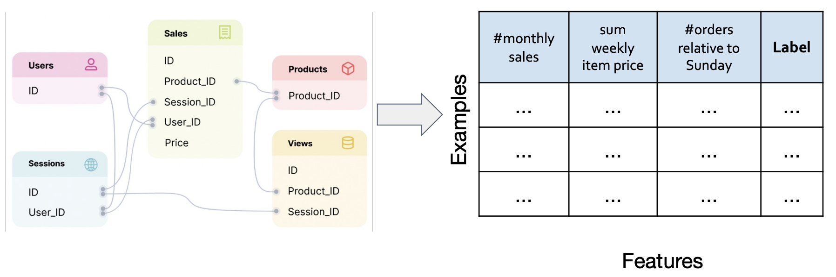
Standard approach to AI models on relational databases
Feature selection / engineering using subset of tables / features
Only a limited set of data is used
High potential for point-in-time errors / information leakage
Image credit: Jure Leskovec, http://cs224w.stanford.edu

Slide 13
Standard approach to AI models on relational databases
Feature selection / engineering using subset of tables / features
Only a limited set of data is used
High potential for point-in-time errors / information leakage
Typically, several months of development time
Image credit: Jure Leskovec, http://cs224w.stanford.edu

Slide 14
Standard approach to AI models on relational databases
Feature selection / engineering using subset of tables / features
Only a limited set of data is used
High potential for point-in-time errors / information leakage
Typically, several months of development time
Can we leverage the data in its existing database form without going through the longest duration tasks?
Image credit: Jure Leskovec, http://cs224w.stanford.edu

Slide 15
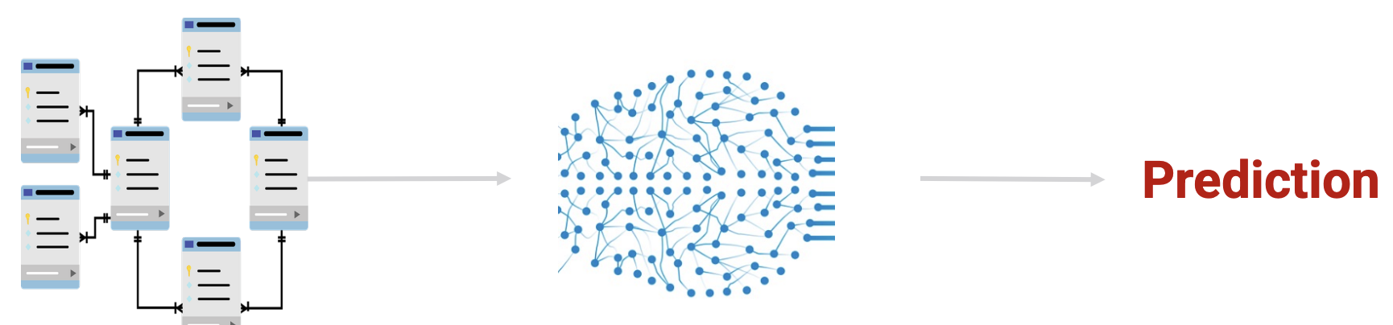
Deep learning on databases?
Can we leverage the data in its existing database form without going through the longest duration model development tasks?
Image credit: Jure Leskovec, http://cs224w.stanford.edu

Slide 16
Relational deep learning

Slide 17
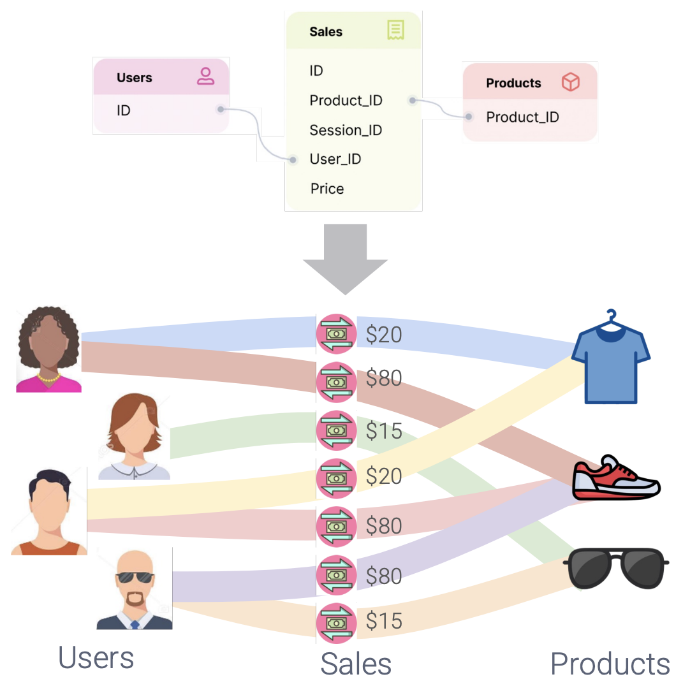
Databases are graphs
Rows in tables can be viewed as nodes
Relations (foreign keys) between rows in different tables can be viewed as edges between nodes
Image credit: Jure Leskovec, http://cs224w.stanford.edu

Slide 18
Databases are graphs
Rows in tables can be viewed as nodes
Relations (foreign keys) between rows in different tables can be viewed as edges between nodes
Can we convert the database to a graph and perform machine learning using GNN concepts?
Image credit: Jure Leskovec, http://cs224w.stanford.edu

Slide 19
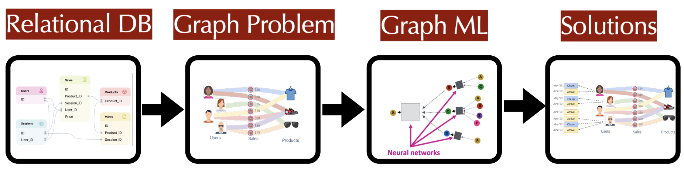
Database to graph ML pipeline
Can we convert the database to a graph and perform machine learning using GNN concepts?
This is the purpose of relational deep learning
Image credit: Jure Leskovec, http://cs224w.stanford.edu

Slide 20
Relational deep learning pipeline
Three main steps to relational deep learning (RDL)
Formulate the predictive task and generate a training table
Generate the graph representation of the database (including the training table)
Develop the graph machine learning model
Image credit: Jure Leskovec, http://cs224w.stanford.edu

Slide 21
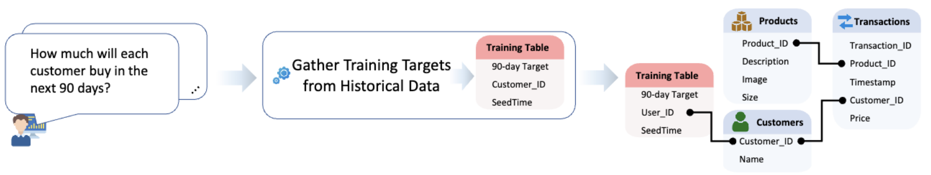
Step 1: RDL task and training table formulation
Three steps (not to be confused with the 3 RDL steps)
Formulate a question for which supervised examples can be created directly from historical data in the database
Create a training table that contains supervision samples with three features:
label – answer to the question
entity id (foreign key) to another table (depends on the question)
seed time (the time point at which the label applies)
Integrate the training table into the database (update the schema)
Image credit: Jure Leskovec, http://cs224w.stanford.edu

Slide 22
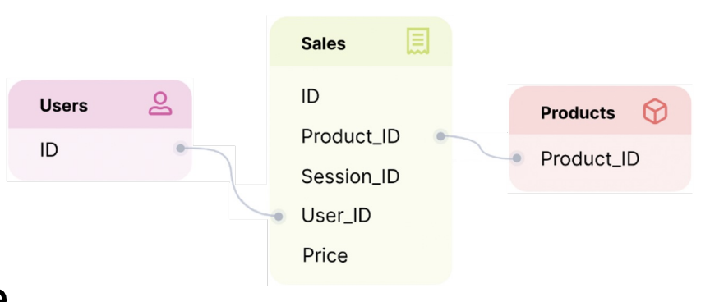
Step 1: RDL task and training table formulation example
Predict whether a user is going to churn (not buy anything) in the next 30 days?
Samples can be generated from the Users and Sales tables
The entity is a user from the Users table
The label (churn) is determined by examining the historical entries in the Sales table for a given user
This task is temporal:
Users’s label changes over time
Multiple samples can be created for a given user at different times
Timestamp
Image credit: Jure Leskovec, http://cs224w.stanford.edu

Slide 23
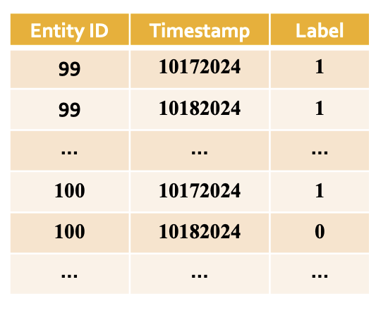
Step 1: RDL task and training table formulation example
Predict whether a user is going to churn (not buy anything) in the next 30 days?
The training table contains
label – churn (sales in last 30 days)
entity id – foreign key to a user_id
seed time (the time point at which the label is applies)
All training table entries are derived directly from the database historical data
Timestamp
Image credit: Jure Leskovec, http://cs224w.stanford.edu

Slide 24
Relational deep learning pipeline
Three main steps to relational deep learning (RDL)
✔️Formulate the predictive task and generate a training table
Generate the graph representation of the database (including the training table)
Develop the graph machine learning model
Image credit: Jure Leskovec, http://cs224w.stanford.edu

Slide 25
Step 2: Database graph representation
Mathematical definition of a database
The database will be represented by two graphs
Schema graph
Relational entity graph

Slide 26
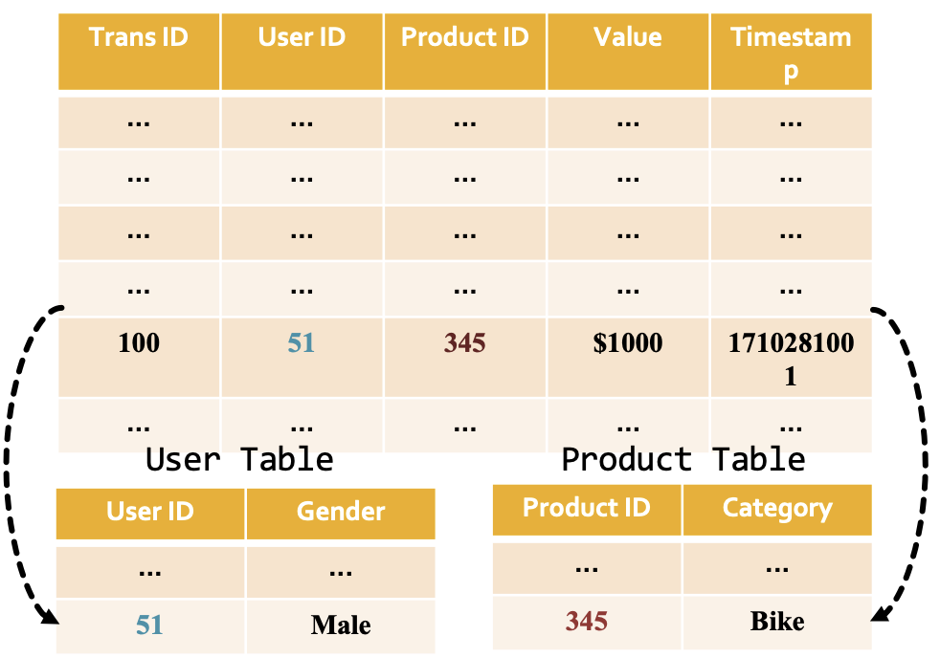
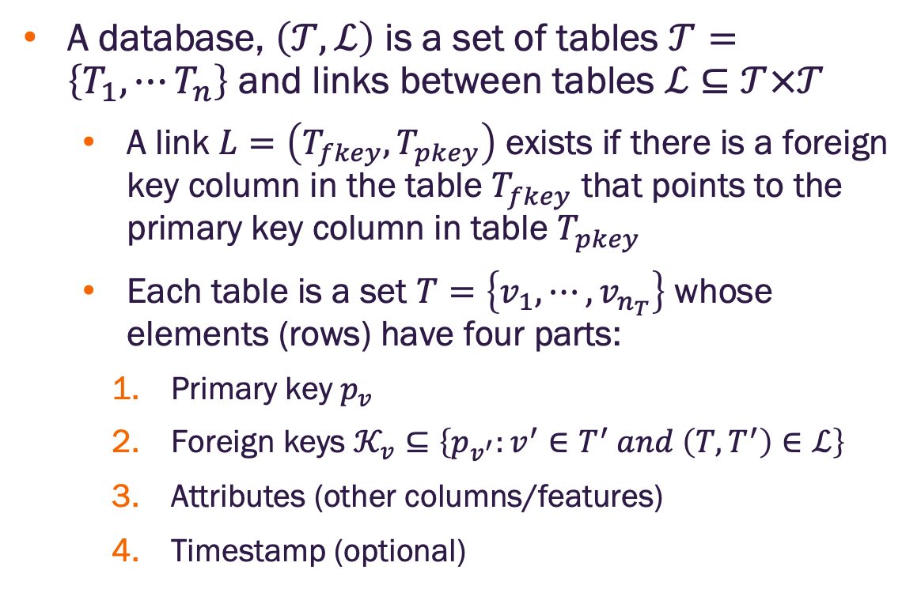
Step 2: Database mathematical definition
A database, $\left(𝒯,ℒ\right)$ is a set of tables $𝒯=\left\{T_{1},⋯T_{n}\right\}$ and links between tables $ℒ⊆𝒯×𝒯$
A link $L=\left(T_{fkey},T_{pkey}\right)$ exists if there is a foreign key column in the table $T_{fkey}$ that points to the primary key column in table $T_{pkey}$
Each table is a set $T=\left\{v_{1},⋯,v_{n_{T}}\right\}$ whose elements (rows) have four parts:
Primary key $p_{v}$
Foreign keys $𝒦_{v}⊆\left\{p_{v^{′}}:v^{′}∈T^{′} and \left(T,T^{′}\right)∈ℒ\right\}$
Attributes (other columns/features)
Timestamp (optional)
Image credit: Jure Leskovec, http://cs224w.stanford.edu

Slide 27
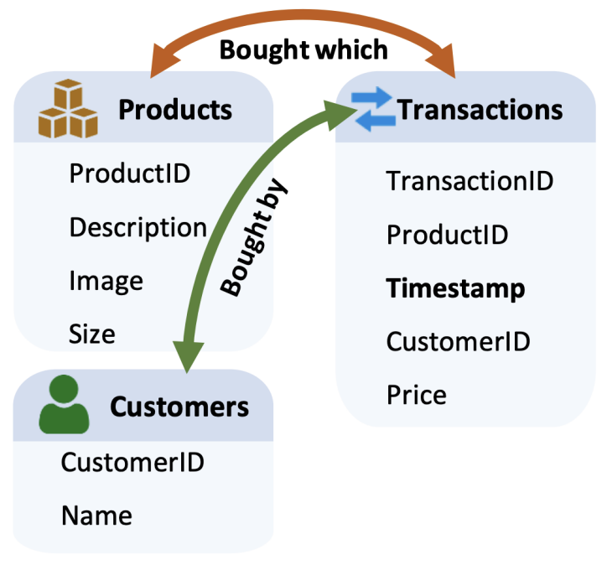
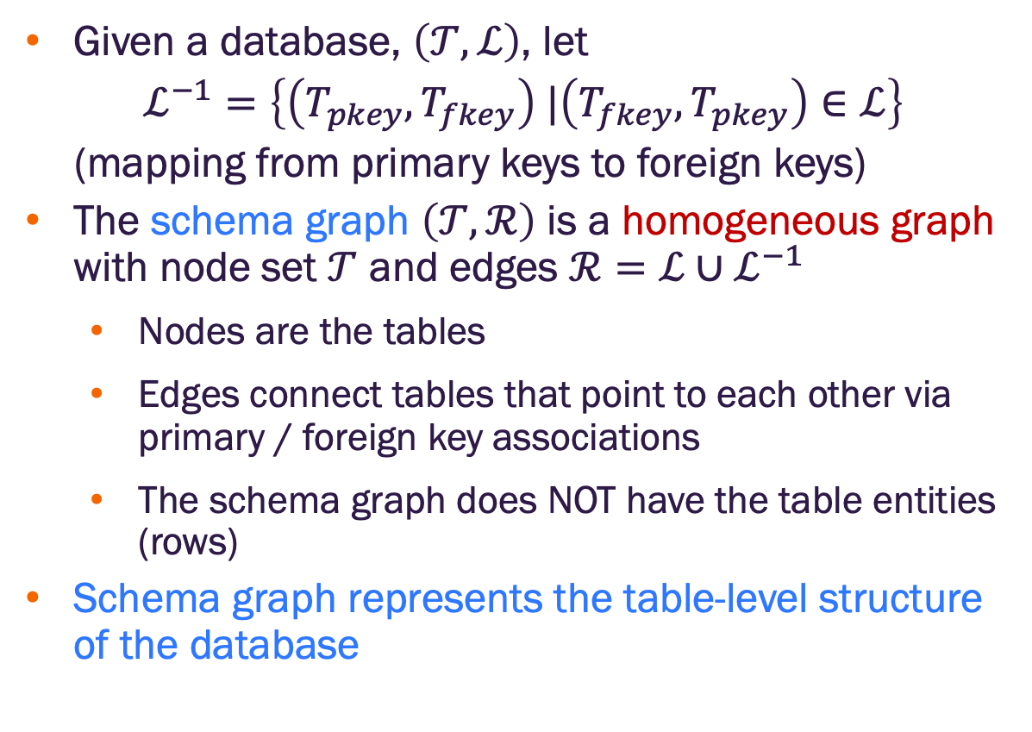
Step 2: Schema graph
Given a database, $\left(𝒯,ℒ\right)$, let
$ℒ^{−1}=\left\{\left(T_{pkey},T_{fkey}\right) |\left(T_{fkey},T_{pkey}\right)∈ℒ\right\}$
(mapping from primary keys to foreign keys)
The schema graph $\left(𝒯,ℛ\right)$ is a homogeneous graph with node set $𝒯$ and edges $ℛ=ℒ∪ℒ^{−1}$
Nodes are the tables
Edges connect tables that point to each other via primary / foreign key associations
The schema graph does NOT have the table entities (rows)
Schema graph represents the table-level structure of the database
Image credit: Jure Leskovec, http://cs224w.stanford.edu

Slide 28
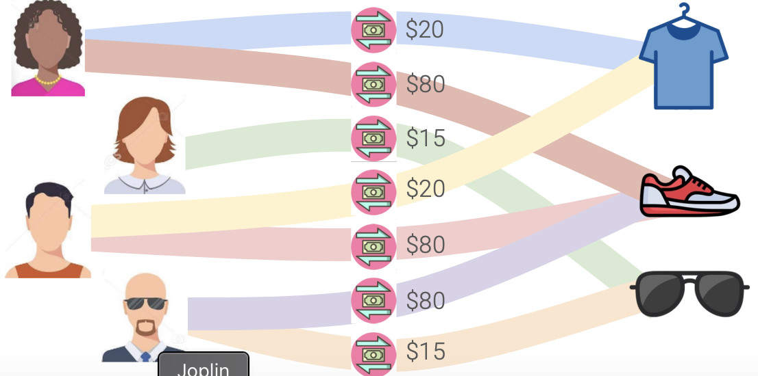
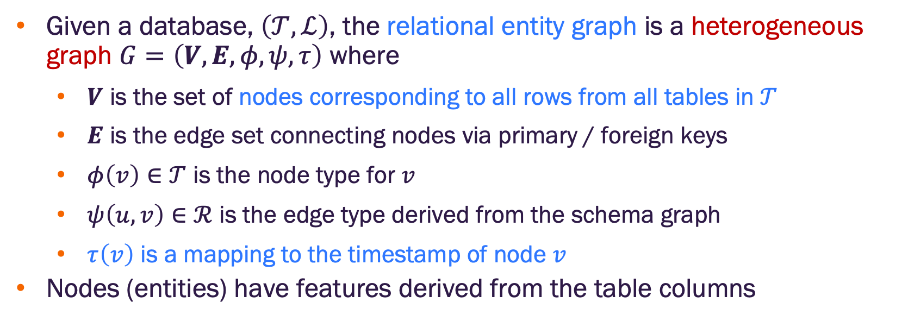
Step 2: Relational entity graph
Given a database, $\left(𝒯,ℒ\right)$, the relational entity graph is a heterogeneous graph $G=\left(V, E, φ,ψ,τ\right)$ where
$V$ is the set of nodes corresponding to all rows from all tables in $𝒯$
$E$ is the edge set connecting nodes via primary / foreign keys
$φ\left(v\right)∈𝒯$ is the node type for $v$
$ψ\left(u,v\right)∈ℛ$ is the edge type derived from the schema graph
$τ\left(v\right)$ is a mapping to the timestamp of node $v$
Nodes (entities) have features derived from the table columns
Image credit: Jure Leskovec, http://cs224w.stanford.edu

Slide 29
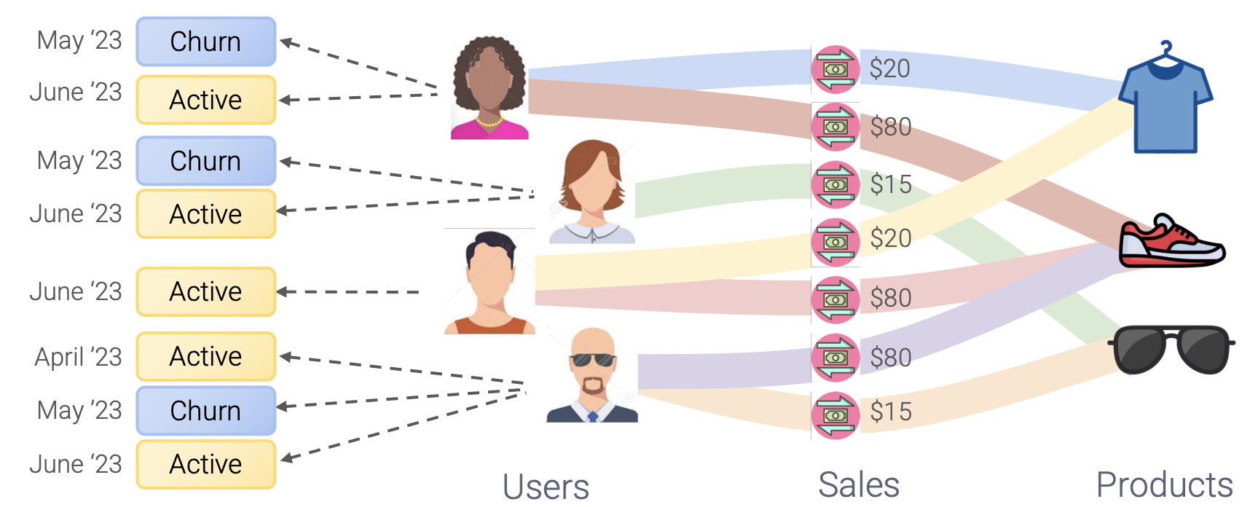
Step 2: Relational entity graph
The relational entity graph is completed by:
Creating “sample” nodes from the training table rows. The sample nodes have two features: label (from the predictive task), and timestamp
Adding edges from the sample nodes to the appropriate entity nodes defined by the foreign key used in the training table
Image credit: Jure Leskovec, http://cs224w.stanford.edu

Slide 30
Relational deep learning pipeline
Three main steps to relational deep learning (RDL)
✔️Formulate the predictive task and generate a training table
✔️ Generate the graph representation of the database (including the training table)
Develop the graph machine learning model
Image credit: Jure Leskovec, http://cs224w.stanford.edu

Slide 31
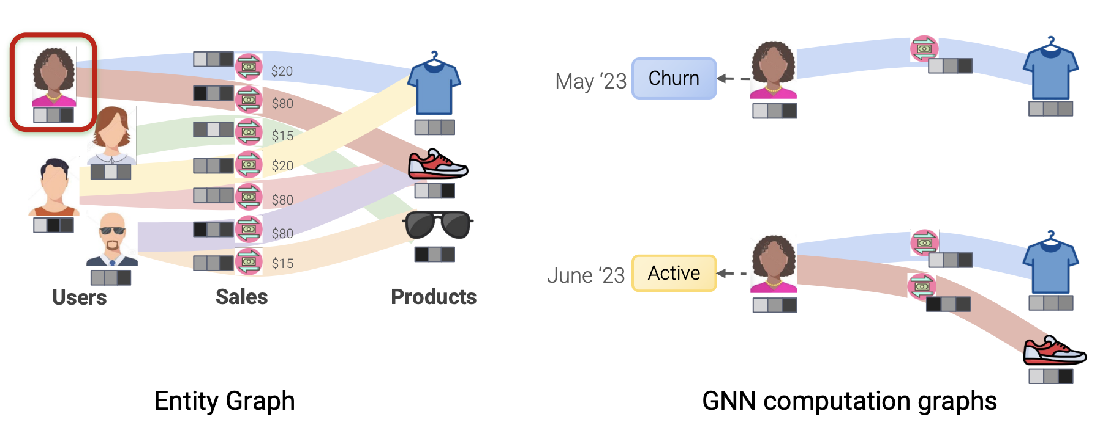
Step 3: Develop the GNN
The relation entity graph is a heterogenous graph
We can apply message passing GNNs to update the node embeddings
We can create prediction heads for node / graph / edge inference tasks
Image credit: Jure Leskovec, http://cs224w.stanford.edu

Slide 32
Step 3: Develop the GNN
The relation entity graph is a heterogenous graph
We can apply message passing GNNs to update the node embeddings
We can create prediction heads for node / graph / edge inference tasks
There is one issue to resolve – temporality. The entity relation graph has information for all time up to present. But training samples correspond to past time points where some of this data did not exist.
Image credit: Jure Leskovec, http://cs224w.stanford.edu

Slide 33
Step 3: Develop the GNN
There is one issue to resolve – temporality. We need to prevent “future” data from ”leaking” into the computation for a given sample, i.e., we can only use nodes that represent data that existed at the time of the training sample
The computation graph for each node is time dependent
Message aggregation becomes time-dependent
Sampling over neighbors is time-dependent
Image credit: Jure Leskovec, http://cs224w.stanford.edu

Slide 34
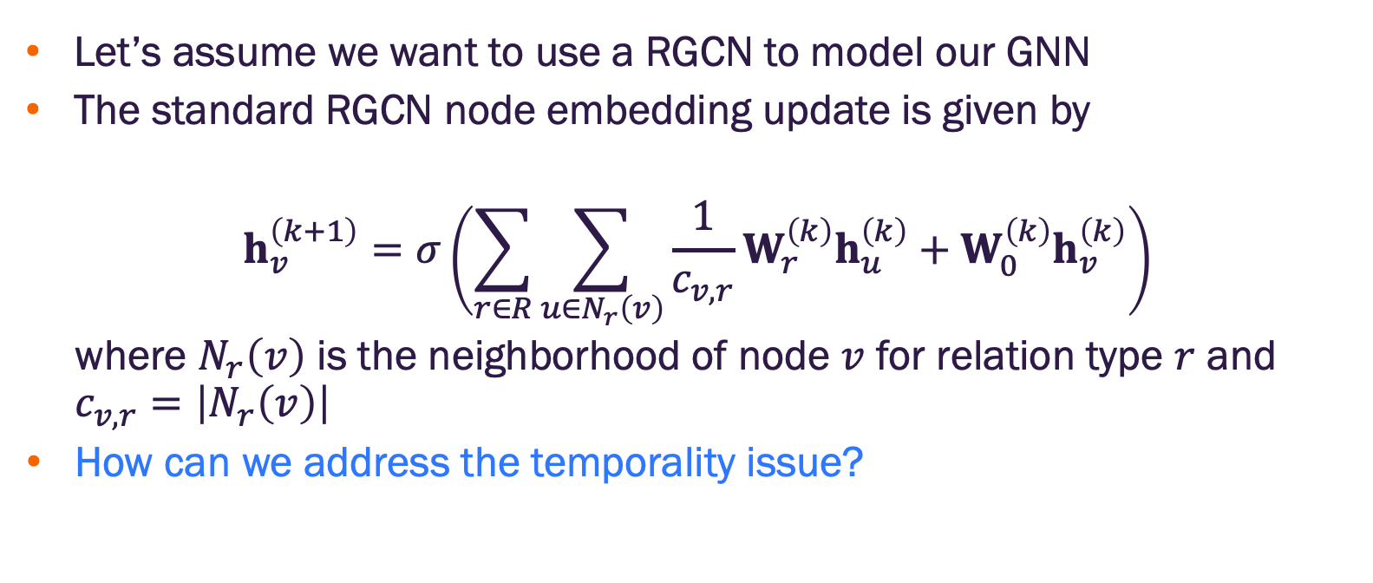
Step 3: Develop the GNN
Let’s assume we want to use a RGCN to model our GNN
The standard RGCN node embedding update is given by
$$h_{v}^{\left(k+1\right)}=σ\left(\sum_{r∈R}{\sum_{u∈N_{r}\left(v\right)}{\frac{1}{c_{v,r}}W_{r}^{\left(k\right)}h_{u}^{\left(k\right)}}}+W_{0}^{\left(k\right)}h_{v}^{\left(k\right)}\right)$$
where $N_{r}\left(v\right)$ is the neighborhood of node $v$ for relation type $r$ and $c_{v,r}=\left|N_{r}\left(v\right)\right|$
How can we address the temporality issue?

Slide 35
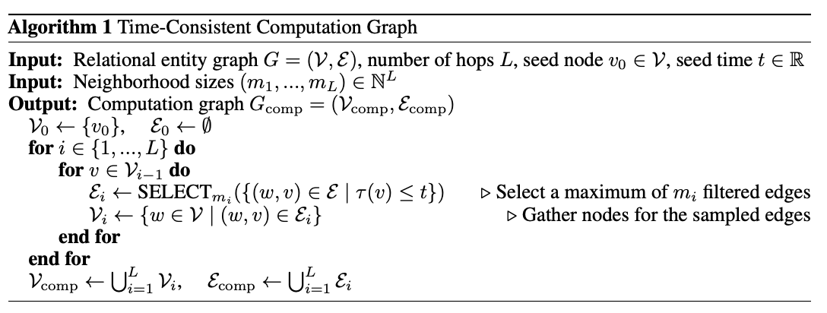
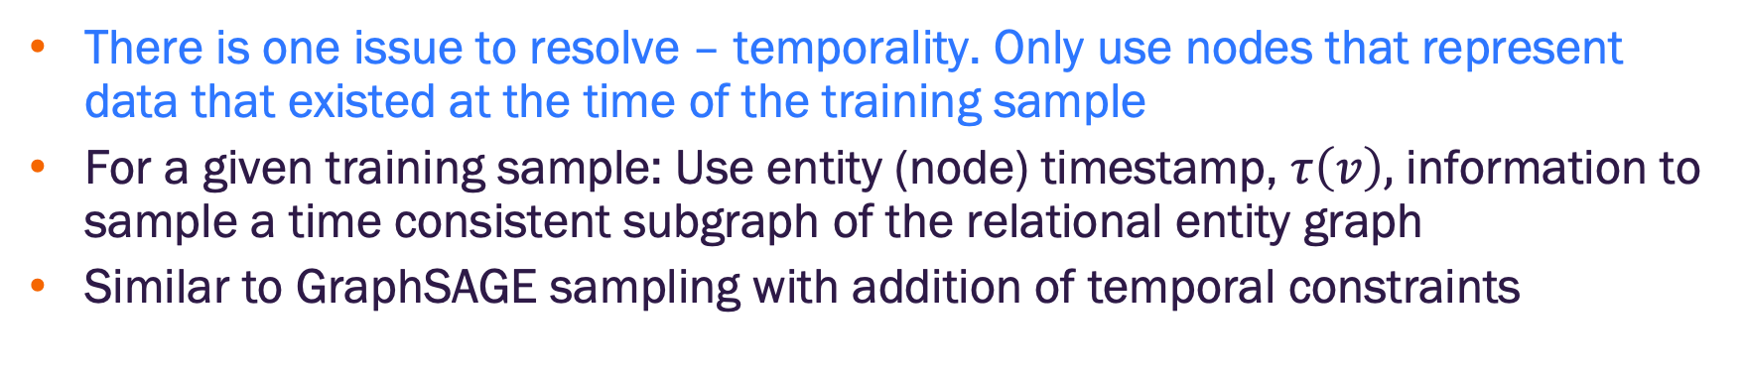
Step 3: Time consistent computation graphs
There is one issue to resolve – temporality. Only use nodes that represent data that existed at the time of the training sample
For a given training sample: Use entity (node) timestamp, $τ\left(v\right),$ information to sample a time consistent subgraph of the relational entity graph
Similar to GraphSAGE sampling with addition of temporal constraints
https://arxiv.org/pdf/2312.04615

Slide 36
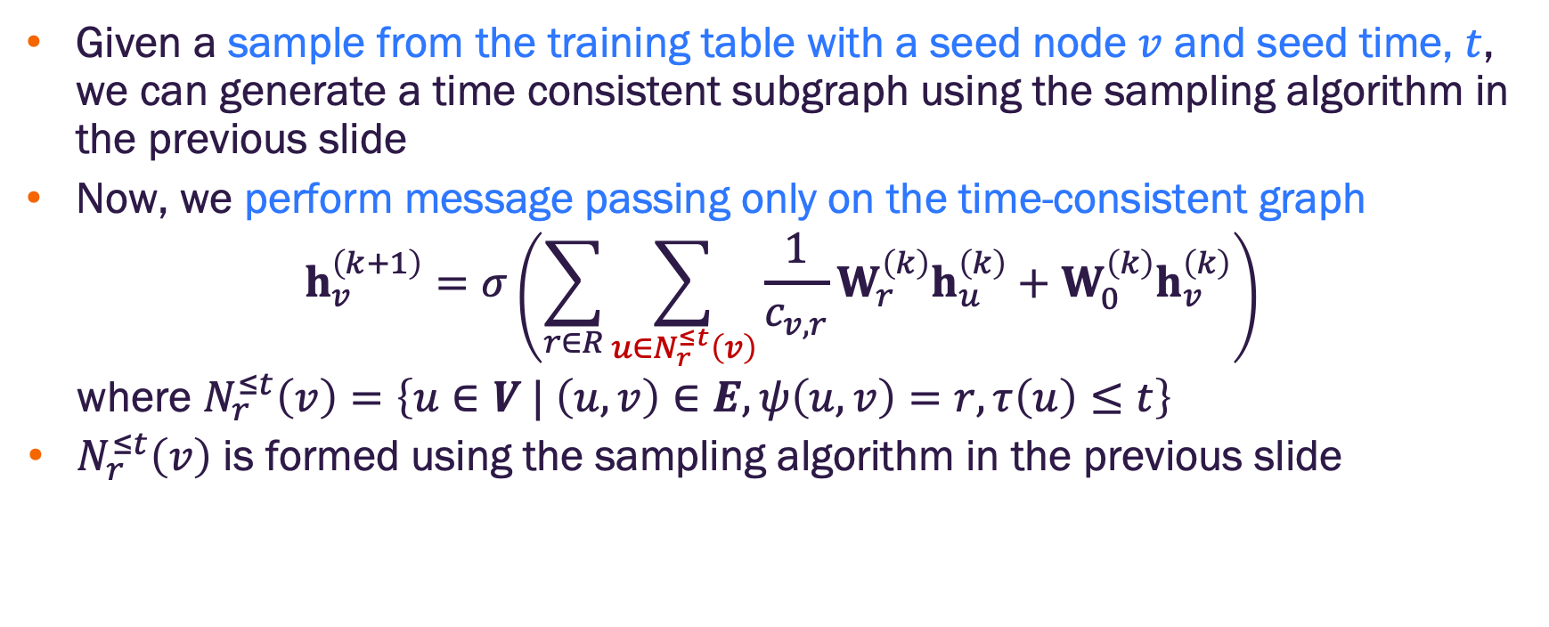
Step 3: Temporal message passing
Given a sample from the training table with a seed node $v$ and seed time, $t$, we can generate a time consistent subgraph using the sampling algorithm in the previous slide
Now, we perform message passing only on the time-consistent graph
$$h_{v}^{\left(k+1\right)}=σ\left(\sum_{r∈R}{\sum_{u∈N_{r}^{≤t}\left(v\right)}{\frac{1}{c_{v,r}}W_{r}^{\left(k\right)}h_{u}^{\left(k\right)}}}+W_{0}^{\left(k\right)}h_{v}^{\left(k\right)}\right)$$
where $N_{r}^{≤t}\left(v\right)=\left\{u∈V | \left(u,v\right)∈E,ψ\left(u,v\right)=r,τ\left(u\right)≤t\right\}$
$N_{r}^{≤t}\left(v\right)$ is formed using the sampling algorithm in the previous slide
https://arxiv.org/pdf/2312.04615

Slide 37
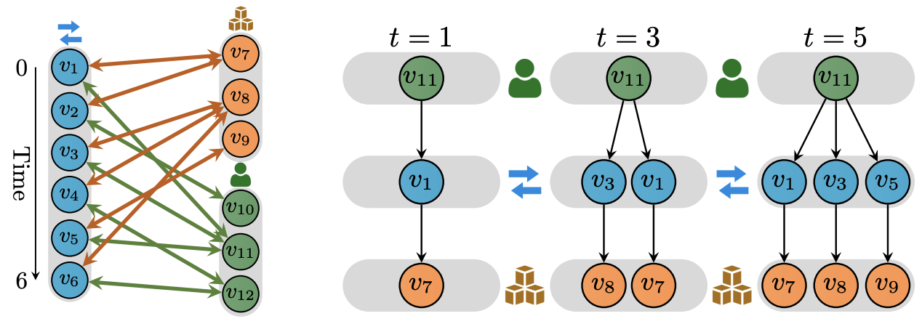
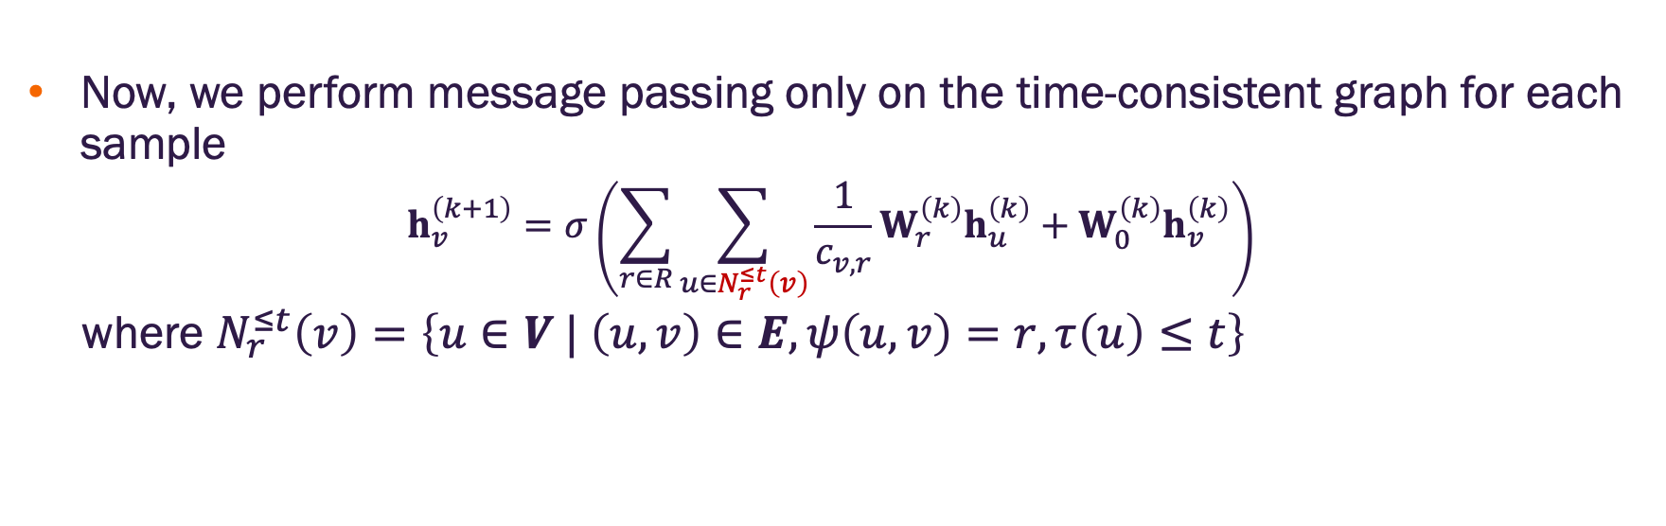
Step 3: Temporal message passing
Now, we perform message passing only on the time-consistent graph for each sample
$$h_{v}^{\left(k+1\right)}=σ\left(\sum_{r∈R}{\sum_{u∈N_{r}^{≤t}\left(v\right)}{\frac{1}{c_{v,r}}W_{r}^{\left(k\right)}h_{u}^{\left(k\right)}}}+W_{0}^{\left(k\right)}h_{v}^{\left(k\right)}\right)$$
where $N_{r}^{≤t}\left(v\right)=\left\{u∈V | \left(u,v\right)∈E,ψ\left(u,v\right)=r,τ\left(u\right)≤t\right\}$
https://arxiv.org/pdf/2312.04615

Slide 38
Relational deep learning pipeline
Three main steps to relational deep learning (RDL)
✔️Formulate the predictive task and generate a training table
✔️ Generate the graph representation of the database (including the training table)
✔️ Develop the graph machine learning model
What have we gained?
Image credit: Jure Leskovec, http://cs224w.stanford.edu

Slide 39
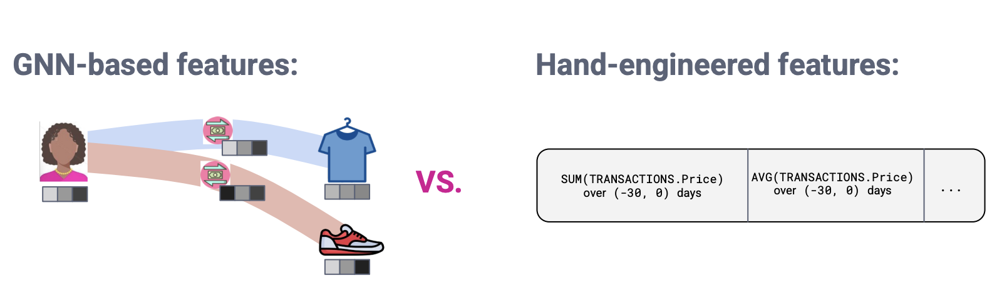
GNN vs. feature engineering
GNN learns how to aggregate entity (row) values to form features that are useful for prediction task
They can discard neighboring node information that is irrelevant for the given downstream task
They can detect fine-grained patterns within local neighborhoods (e.g., buying behavior over the last year)
As with deep learning in other domains, we anticipate these will lead to higher performance
Image credit: Jure Leskovec, http://cs224w.stanford.edu

Slide 40
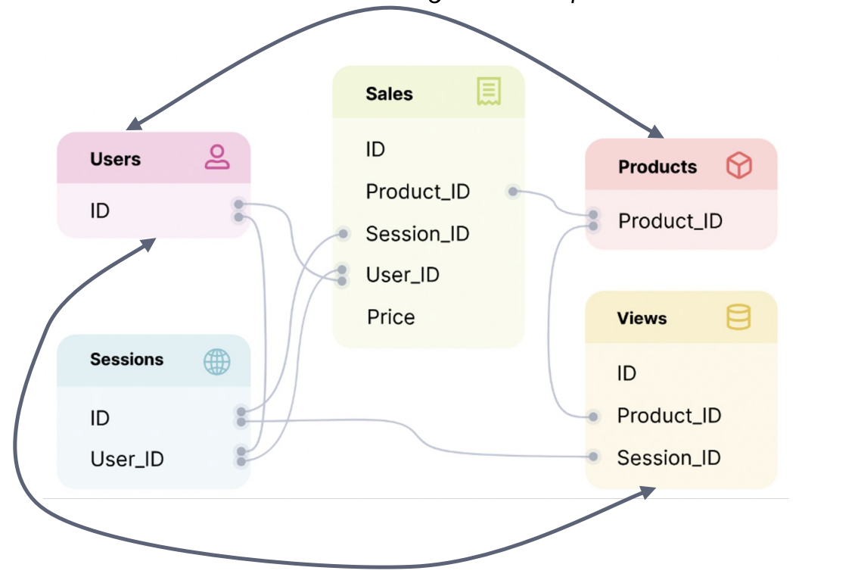
Information exchange
GNNs can exchange information across training examples
Instead of treating examples as isolated, there now exists an inter-dependency between entities
GNN can use these features to enrich an entity’s representation
Information flows between users and products through multiple layers of message passing
Image credit: Jure Leskovec, http://cs224w.stanford.edu

Slide 41
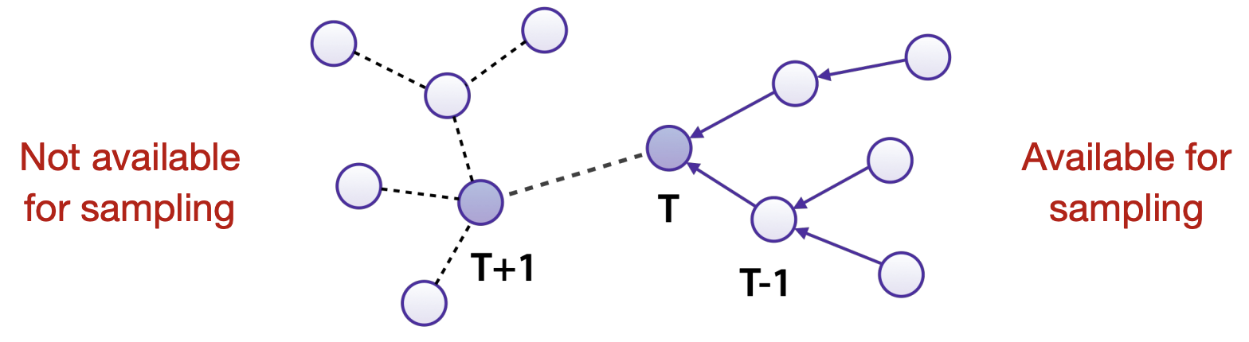
First class temporal information
Capture fine-grained relative and seasonal features via temporal embeddings
Avoid data leakage via temporal sampling directly during data loading
Image credit: Jure Leskovec, http://cs224w.stanford.edu

Slide 42
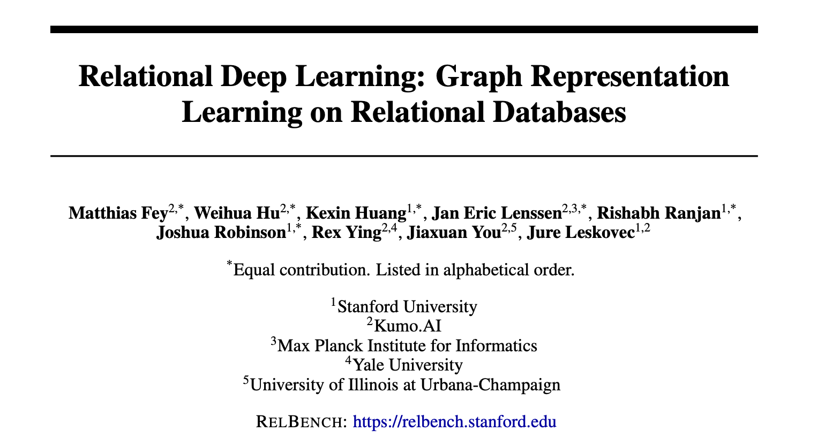
For more information
https://relbench.stanford.edu/
https://arxiv.org/pdf/2312.04615
Image credit: Jure Leskovec, http://cs224w.stanford.edu

Slide 43


